Slide 1
Introduction to OS
T01

Slide 2
What is a computer system?

Slide 3
Abstract view of a computer system
user₁
user₂
user₃
…
user_{n}
system and application programs
compiler
assembler
text editor
…
database system
OPERATING SYSTEM
computer hardware

Slide 4
How does a processor work?

Slide 5
The operation of a simple computer
Fetch stage
Execute stage
Fetch next instruction
Execute instruction
START
HALT

Slide 6
The Operating System is
the body of software in charge of making sure
the system operates correctly and efficiently,
in an easy-to-use manner.

Slide 7
Thus, an Operating System can be seen as …
A virtualizer
Hides the messy details that must be performed
Presents user with a higher-level machine, easier to use
A manager
Manages all resources
Decides between conflicting requests for efficient (and possibly fair) resource use
A controller
Controls program execution to prevent errors and improper use of the computer
An intermediary or mediator
between a user and the computer hardware

Slide 8
And an Operating System is supposed to …
Be reliable
i.e. to do what it is supposed to do.
Be secure
i.e. unlikely to be corrupted by an attacker.
Be efficient
i.e. to impose minimum overhead on the use of a system’s resources.
Be convenient
i.e. to make the computer easier to use.
Be able to evolve
i.e. to provide for effective development, testing, and introduction of new system functions without interfering with service.

Slide 9
Why study Operating Systems?
To learn how computer systems work
To learn about system design
To learn how to manage complexity through appropriate abstractions
To learn how an app interfaces with the physical world
Because OS-like problems are everywhere!

Slide 10
We are going to study four major classes of activities performed by an operating system
Virtualizing the CPU
Virtualizing Memory
Managing Concurrency
Providing data persistence

Slide 11
Agenda

Slide 12
What is CPU Virtualization?

Slide 13
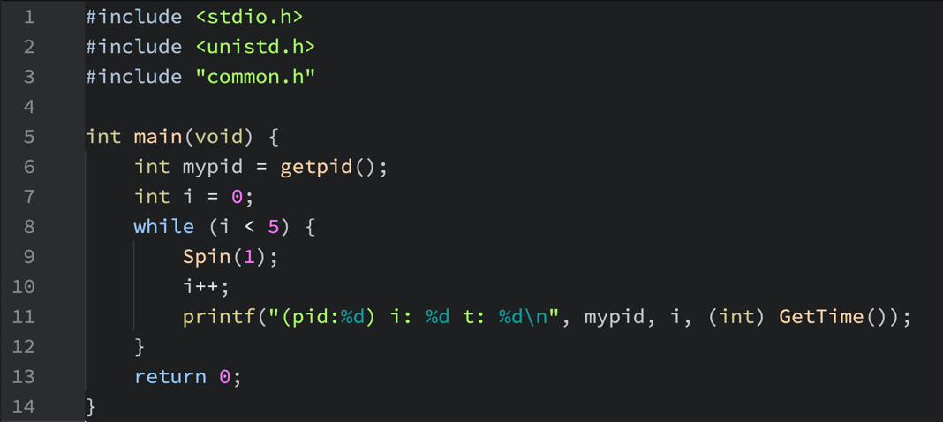
What does this program do?

Slide 14
Let's execute it in Atom
Save it as cpu.c and then compile it with the following command
gcc -o cpu cpu.c –Wall
What will be the result of the execution of the following command?
./cpu
What will be the result of the execution of the following command?
(./cpu) ; (./cpu) ; (./cpu) ; (./cpu)
What will be the result of the execution of the following command?
(./cpu &) ; (./cpu &) ; (./cpu &) ; (./cpu &)
What have you observed? What have you learned?

Slide 15
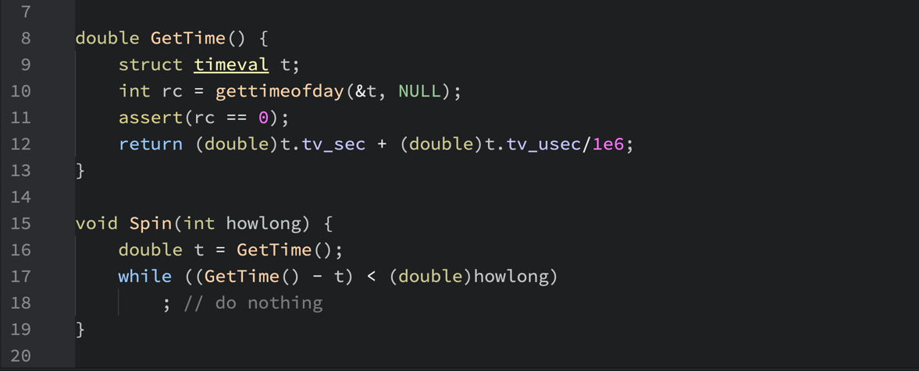
A point to ponder
Spin loops continuously until the required interval is over, as shown by the following code fragments from common.h …
double GetTime() {
struct timeval t;
int rc = gettimeofday(&t, NULL);
assert(rc == 0);
return (double)t.tv_sec + (double)t.tv_usec/1e6;
}
void Spin(int howlong) {
double t = GetTime();
while ((GetTime() - t) < (double)howlong)
; // do nothing
}
So, how could the four tasks run simultaneously?

Slide 16
All tasks seem to be running simultaneously!
Turning a single CPU (or a small set of them) into a seemingly infinite number of CPUs
and thus allowing many programs to seemingly run at once
is what we call virtualizing the CPU.

Slide 17
All tasks seem to be running at the same time!
Turning a single CPU (or a small set of them) into a seemingly infinite number of CPUs
and thus allowing many programs to seemingly run at once
is what we call virtualizing the CPU.

Slide 18
What is Memory Virtualization?

Slide 19
What does this program do?
int main(void) {
int mypid = getpid();
int d = mypid % 10;
int i = 0;
int x = 0;
double t;
while (i < 5) {
Spin(1);
i = i + 1;
x = x + d;
t = GetTime();
printf("(pid:%d) i:%d d:%d x:%02d t:%lf\n", mypid, i, d, x, t);
}
return 0;
}

Slide 20
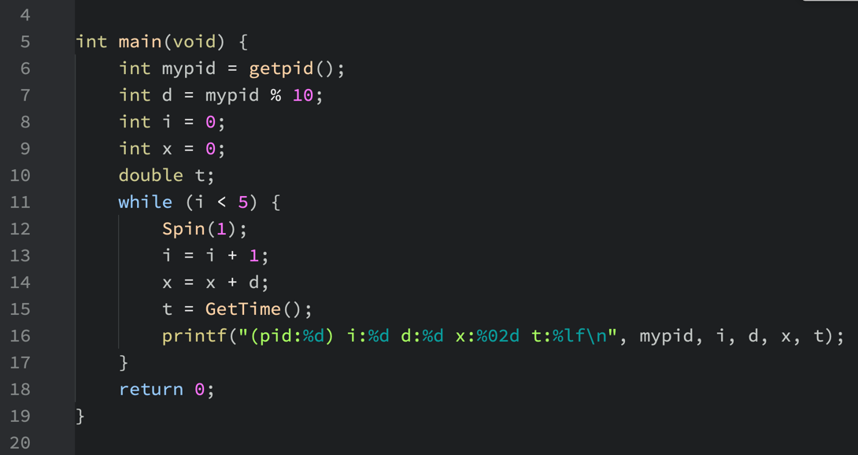
What does this program do?

Slide 21
Let's execute it in Atom
Save it as mem.c and then compile it with the following command
gcc -o mem mem.c –Wall
What will be the result of the execution of the following command?
./mem
What will be the result of the execution of the following command?
(./mem) ; (./mem) ; (./mem) ; (./mem)
What will be the result of the execution of the following command?
(./mem &) ; (./mem &) ; (./mem &) ; (./mem &)
What have you observed? What have you learned?

Slide 22
Points to ponder…
There was only one program ( mem.c ) being executed, with its variables i, d, x, t.
Then how could i, d, x and t have different values at the ”same” time?
If i, d, x and t are at different addresses on each task, who created such addresses?
The compiler?
How could the compiler know how many activations there would be?
If it was not the compiler, who else could have been?

Slide 23
It is as if each running task has its own private memory, instead of sharing the same physical memory with other running tasks.
That is exactly what we call Memory Virtualization.
Each running task accesses its own private virtual address space, which the OS somehow maps onto the physical memory of the machine.

Slide 24
What is Concurrency?

Slide 25
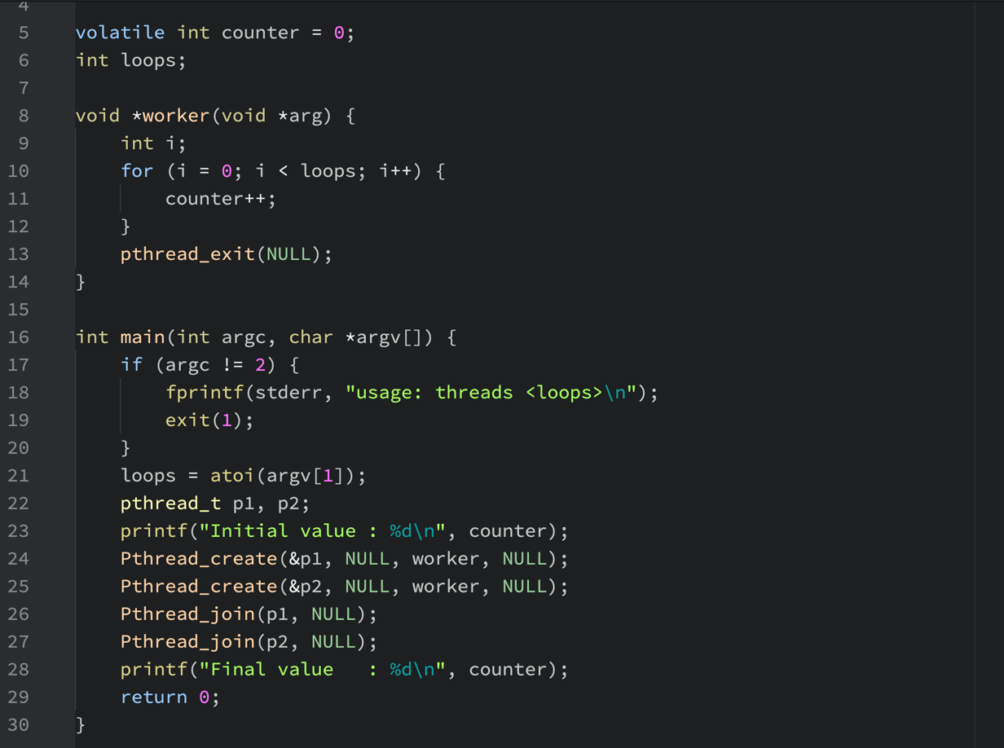
What does this program do?

Slide 26
Let’s take a closer look…

Slide 27
Let’s take a closer look…

Slide 28
Let's execute it in Atom
Save it as threads.c and then compile it with the following command
gcc -o threads threads.c –pthread –Wall
What will be the result of the execution of the following command?
./threads 1000
What will be the result of the execution of the following command?
./threads 10000
Run it again…
./threads 10000
And again…
./threads 10000

Slide 29
Points to ponder…
When we ran the program with high counts of loops, we got inconsistent answers. Why did it happen?
When there are many concurrently executing threads within the same memory space, how can we build a correctly working program?
What primitives are needed from the OS?
Can we implement such primitives exclusively in software or should some mechanisms be provided by the hardware?
How can we use them to solve the problems of concurrency?

Slide 30
Fixing the conflict at counter++ (line 13)
5
12
14

Slide 31
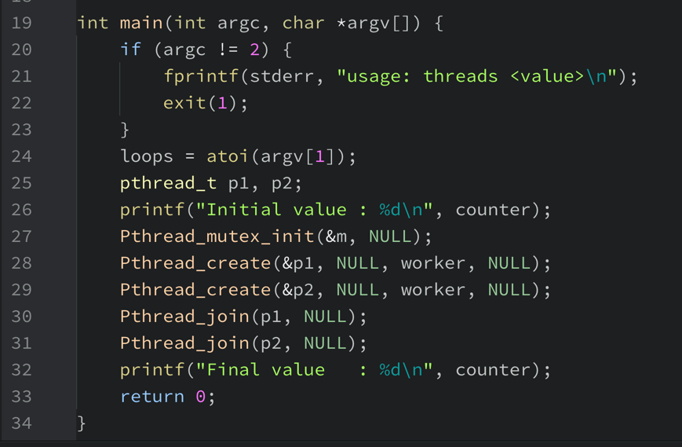
Fixing the conflict at counter++ (line 13)
5
27
14

Slide 32
Let’s re-execute it in Atom
Save it as mutex.c and then compile it with the following command
gcc -o mutex mutex.c –pthread –Wall
What will be the result of the execution of the following command?
./mutex 1000
What will be the result of the execution of the following command?
./mutex 10000
Run it again…
./mutex 10000
And again…
./mutex 10000
Did it work now?

Slide 33
What is Persistence?

Slide 34
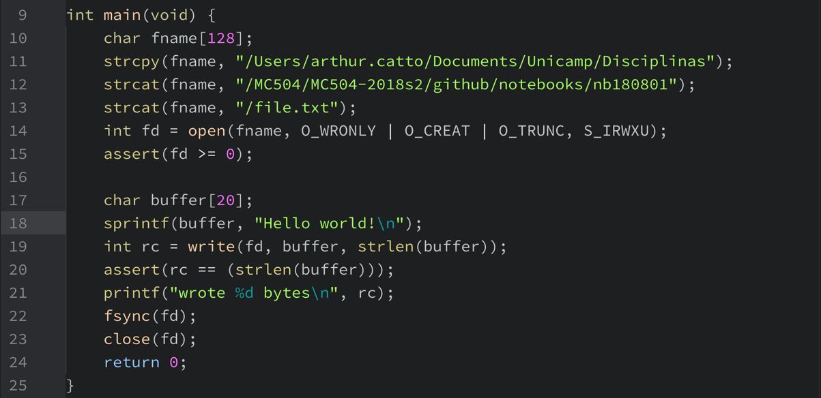
What does this program do?

Slide 35
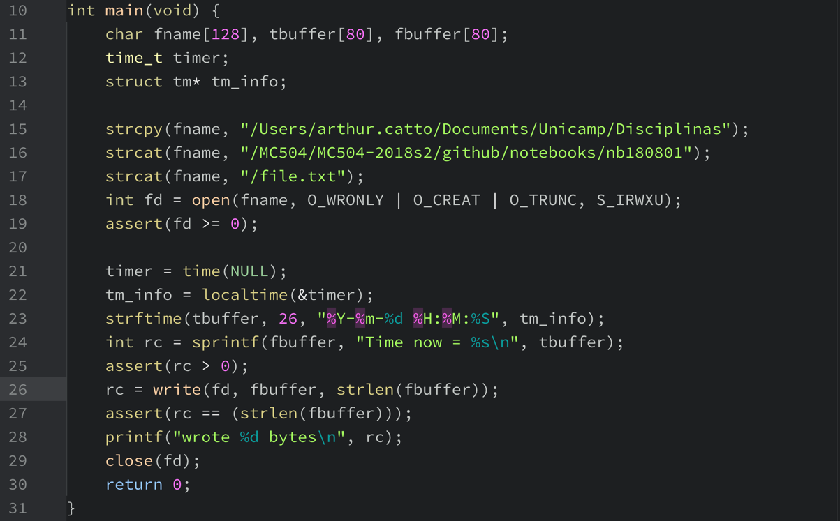
What does this program do?

Slide 36
Let's execute it in Atom
Save it as io.c and then compile it with the following command
gcc -o io io.c –Wall
What will be the result of the execution of the following command?
./io
Did it give the answers you expected? Can you say why?
What have you observed? What have you learned?

Slide 37
Points to ponder
For how long will the file exist?
Who can read, modify or delete the file?
Where on the disk is the file?
Where is the disk that contains the file?
Is the file really on a disk?

Slide 38
Points to ponder
The file system is the part of the OS in charge of managing persistent data.
What techniques are needed to do so correctly?
What mechanisms and policies are required to do so with high performance?
How is reliability achieved, in the face of failures in hardware and software?

Slide 39
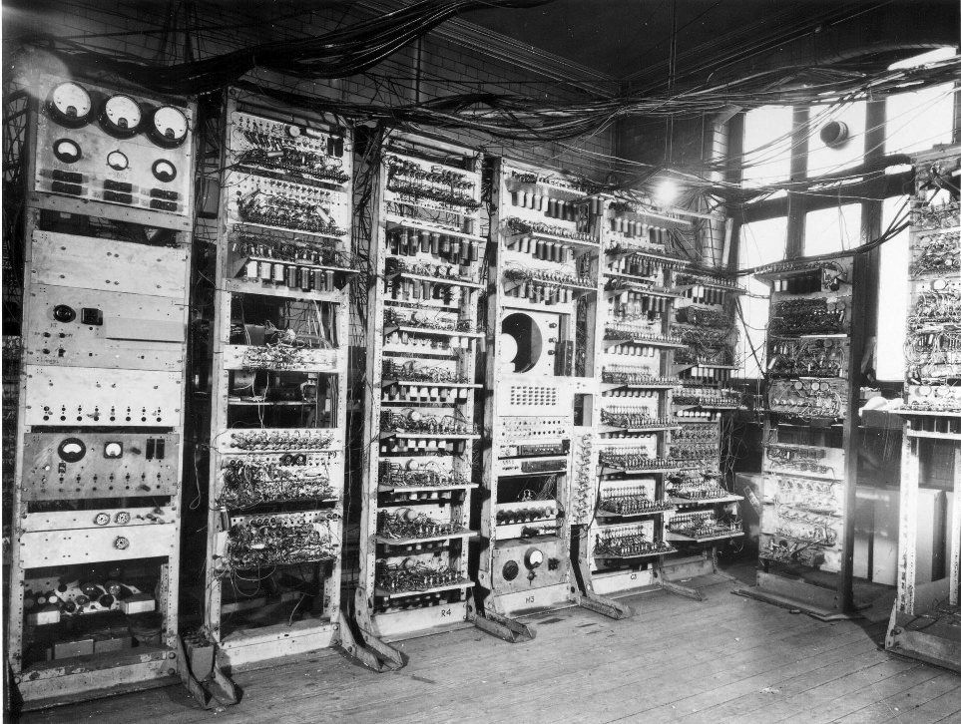

Slide 40


Slide 41
Migration of OS concepts and features
Can computers become smaller?
 | 1950 | 1960 | 1970 | 1980 | 1990 | 2000 | 2010
mainframes
minicomputers
desktops
handhelds
smartphones
wearables
MULTICS
UNIX
UNIX
UNIX
UNIX
UNIX

Slide 42
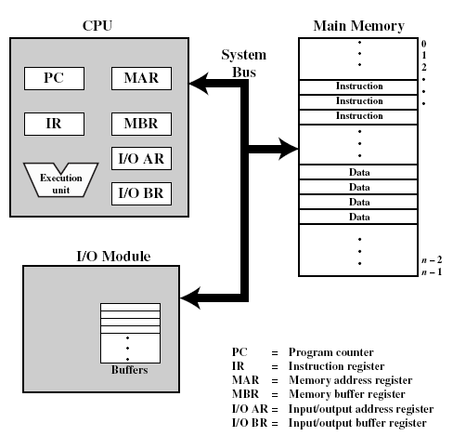
Top-level view of the main computer components
What is a computer?
Processor
Main Memory
Basic elements
System Bus
PC
MAR
Control and state registers
IR
MBR
User accessible registers
I/O AR
Execution unit
I/O BR
PC = Program counter
IR = Instruction register
MAR = Memory address register
MBR = Memory buffer register
I/O AR = Input/output address register
I/O BR = Input/output buffer register
I/O Module

Slide 43
Programmed I/O
Simple computer I/O
I/O module performs the action, not the processor
Sets appropriate bits in the I/O status register
Processor checks status until operation is complete before proceeding to the next instruction
Example of input operation
Issue read command to I/O module
Read status of I/O module
Read word from I/O module
Write word to memory
Ready?
Yes
Done?
Yes
No
No

Slide 44
Flow of Control in Programmed I/O
User program
① write
④ I/O op
I/O program
② write
⑤ end
③
Flow of control
Flow of time
①
④
Processor wait
⑤
②
④
Processor wait
⑤
③
I/O operation
I/O operation

Slide 45
Serial processing
What could be done with a simple computer like that?
No operating system
Machines run from a console with display lights, toggle switches, input device and printer
Setup included
Loading a compiler
Loading source program
Saving compiled program
Loading and linking executable program

Slide 46
Simple Batch Processing
What could be done with a simple computer like that?
Monitors
Software that controls the sequence of events
Batch jobs together
Program branches back to monitor when finished
Job Control Language (JCL)
Special type of programming language
Provides instruction to the monitor
What compiler to use
What data to use

Slide 47
Memory scheme in a simple batch system
Operating System
User Program Area

Slide 48
Uniprogramming
Processor must wait for I/O instruction to complete before proceeding
Run
Wait
Run
Wait
Program A

Slide 49
I/O devices are too slow
What is the problem with waiting?
Access Time |  |  |  |  |  |  |  |  | Capacity
Volatile | 1 nsec |  |  |  | Registers |  |  |  | Kilobytes
 | 2 nsec |  |  | Cache |  |  |  |  | Megabytes
 | 10 nsec |  | Main memory |  |  |  |  |  | Gigabytes
Non-volatile | 10 msec | Magnetic disk |  |  |  |  |  |  | Terabytes
The numbers are very rough approximations as of today.

Slide 50
Basic instruction cycle with interrupts
Fetch stage
Execute stage
Interrupt stage
Interrupts disabled
Fetch next instruction
Execute instruction
Interrupt checking and treatment
START
Interrupts enabled
HALT

Slide 51
Interrupt-driven I/O or how to harness slack time
Processor is interrupted when I/O module ready to exchange data
Processor saves context of program executing and begins executing interrupt-handler
No needless waiting
Consumes a lot of processor time because every word read or written passes through the processor
Example of interrupt-driven input operation
No
Issue read command to I/O module
Read status of I/O module
Read word from I/O module
Write word to memory
Ready?
Yes
Done?
Yes
No
next instruction
do something else
interrupt
error condition

Slide 52
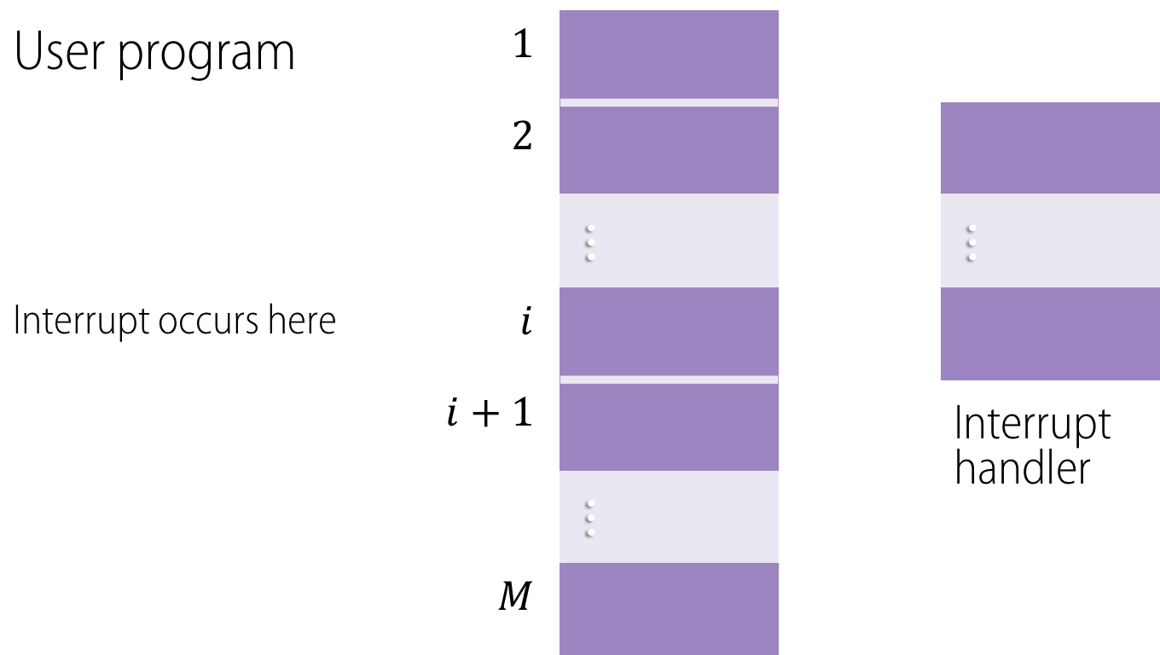
Transfer of control under an interrupt
User program | $$1$$
 | $$2$$
 |  | ... |  |  | ...
Interrupt occurs here | $$i$$
 | $$i+1$$ |  |  |  | Interrupt handler
 |  | ...
 | $$M$$

Slide 53
Flow of Control with Short I/O Wait
User program
① write
④ I/O op
I/O program
②
② write
Interrupt occurs here
② write
⑤ end
Interrupt handler
③
③
③
Flow of control
Flow of time
①
④
②
⑤
②
④
③
⑤
③
I/O operation
I/O operation

Slide 54
Flow of Control with Long I/O Wait
User program
① write
④ I/O op
I/O program
② write
Interrupt occurs here
⑤ end
Interrupt handler
③
Flow of control
Flow of time
①
④
②
Processor wait
⑤
④
③
Processor wait
⑤
I/O operation
I/O operation

Slide 55
Simple Interrupt Processing
Device controller or other system hardware issues an interrupt
Processor pushes PSW and PC onto control stack
Save remainder of process state information
Processor finishes execution of current instruction
Processor loads new PC value based on interrupt
Process the interrupt
Processor signals acknowledgement of interrupt
Restore process state information
Restore old PSW and PC
Hardware
Software

Slide 56
Classes of Interrupts
Program | Generated by a condition that occurs as a result of an instruction execution, such as arithmetic overflow, division by zero, attempt to execute an illegal instruction or reference outside a user's allowed memory space.
Timer | Generated by a timer within the processor. This allows the operating system to perform certain functions on a regular basis.
I/O | Generated by an I/O controller, to signal normal completion of an operation or an error condition.
Hardware failure | Generated by a failure, such as power failure or memory parity error.

Slide 57
Multiprogrammed batch systems
Single user cannot keep CPU and I/O devices busy at all times
Multiprogramming organizes jobs (code and data) so CPU always has one to execute
A subset of total jobs in system is kept in memory
One job selected and run via job scheduling
When it has to wait (for I/O for example), OS switches to another job
Operating System
Job 1
Job 2
Job 3
Job 4

Slide 58
Multiprogramming two jobs
When one job needs to wait for I/O, the processor can switch to another job
Program A | Run | Wait |  |  |  | Run | Wait
Program B | Wait | Run | Wait |  |  |  | Run | Wait
Combined | Run A | Run B | Wait |  |  | Run A | Run B | Wait

Slide 59
Multiprogramming three jobs
Program A | Run | Wait |  |  |  | Run
Program B | Wait | Run | Wait |  |  |  | Run | Wait | Run
Program C | Wait |  | Run | Wait |  |  |  | Run
Combined | Run A | Run B | Run C | Wait |  | Run A | Run B | Run C | Run | Wait

Slide 60
Hardware features for multiprogramming
Timer
Dual-mode operation
Interrupts
Memory Protection
Privileged Instructions

Slide 61
Hardware features for multiprogramming
Timer
Enables interrupting a user job after a certain amount of time
Dual-mode operation
Interrupts
Memory Protection
Privileged Instructions

Slide 62
Hardware features for multiprogramming
Timer
Enable switching between jobs while waiting for I/O to complete
Dual-mode operation
Interrupts
Memory Protection
Privileged Instructions

Slide 63
Hardware features for multiprogramming
Timer
User jobs cannot execute certain machine level instructions
Dual-mode operation
Interrupts
Memory Protection
Privileged Instructions

Slide 64
Hardware features for multiprogramming
Timer
A job cannot alter the memory area of the system or of another job
Dual-mode operation
Interrupts
Memory Protection
Privileged Instructions

Slide 65
Hardware features for multiprogramming
Timer
Jobs execute in user mode
Privileged instructions may not be executed
OS executes in system (aka kernel) mode
Privileged instructions may be executed
Protected areas of memory may be accessed
Dual-mode operation
Interrupts
Memory Protection
Privileged Instructions

Slide 66
Key elements of an OS for Multiprogramming
Operating System
Service call from Process
Service call handler (code)
Interrupt from Process
Interrupt handler (code)
Long- term queue
Short- term queue
I/O queues
Interrupt from I/O
Long-term Scheduler (code)
Short-term Scheduler (code)
Pass control to process

Slide 67
The traditional UNIX layered system structure
(the users)
shells and commands compilers and interpreters system libraries
system-call interface to the kernel
signals terminal handling character I/O system terminal drivers | file system swapping block I/O system disk and tape drivers | CPU scheduling page replacement demand paging virtual memory
kernel interface to the hardware
terminal controllers terminals | device controllers disks and tapes | memory controllers physical memory
kernel
hw

Slide 68
Virtual Machine Concept
Applications and processes |  | Applications and processes | … | Applications and processes
Virtual machine 1 |  | Virtual machine 2 | … | Virtual machine n
Virtual machine monitor
Host operating system
Shared hardware

Slide 69
The process concept
A process is …
… a program in execution.
… an instance of a program running on a computer.
… an entity that can be assigned to and executed on a processor.
… a unit of activity characterized by sequential threads of execution, a current state, and an associated set of system resources.

Slide 70
A process …
Consists of three components
An executable program
Associated data needed by the program
Execution context of the program aka process state
All information the operating system needs to manage the process
Needs resources to accomplish its task
CPU, memory, I/O, files
Initialization data
On termination, requires reclaim of any reusable resources

Slide 71
Simple process implementation
Main memory
Processor registers
Process index
i
PC
i
Process
Base
b
list
j
Limit
h
A few concerns…
Does a process need to be wholly loaded in memory?
Can processes be switched in and out of memory?
If so, does a process need to be reloaded to the same memory addresses where it has been before?
Other registers
Context
Process
Data
A
Program
(code)
b
Context
Process
h
Data
B
Program
(code)

Slide 72
Operating system operation
User process
User mode (mode bit = 1)
user process executing
does system call
continues execution
trap mode bit ← 0
mode bit ← 1 return
Kernel
treats the call
Kernel mode (mode bit = 0)

Slide 73
Virtual Memory
How to isolate one process from another?
Memory is addressed from a logical point of view.
Each process gets a continuous address range which may be larger than that of the actual processor.
Virtual memory addresses are not linked to actual memory addresses.
How can this be achieved?

Slide 74
Virtual Memory Addressing
Virtual address
Real address
Processor
Memory Management Unit
Main memory
Disk address
Secondary memory

Slide 75
E.g. Paging
How to implement virtual memory?
Virtual memory is divided into a number of fixed-size blocks called pages.
Virtual address is given by a page number and an offset within the page.
Actual memory is divided into a number of fixed-size blocks called frames.
A page can be placed in any available frame.
For each process, a page table gives the number of the frame where each page has been loaded.
Real address or physical address refers to main memory and is given by that frame number and the same offset of the logical address in the corresponding page.

Slide 76
Virtual Memory
A.1
A.0
A.2
A.5
0
0
1
1
Main memory
Divided into a number of fixed-length frames, the same size of pages.
For a program to execute at least one of its pages must be loaded in a frame in main memory.
Disk
Secondary memory can hold many fixed-length pages.
A user program consists of some number of pages.
Pages for all programs (including OS) are on disk.
B.0
B.1
B.2
B.3
2
2
3
3
4
4
5
5
A.7
6
6
A.9
7
User
8
program
9
B
A.8
10
User
program
A
B.5
B.6
Main Memory
Disk

Slide 77
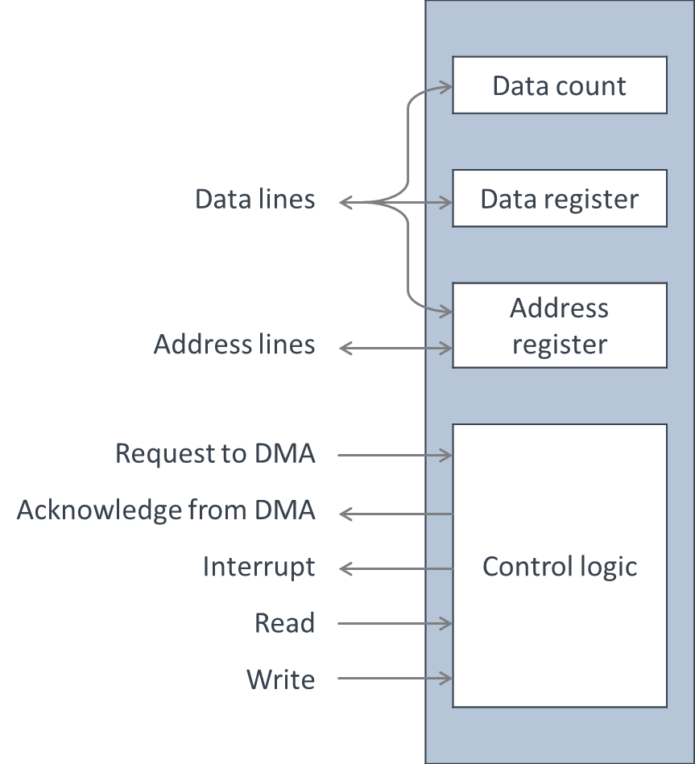
Direct Memory Access
Can I/O operation speed be improved?
 |  |  | Data count
Data lines |  |  | Data register
Address lines |  |  | Address register
Request to DMA |  |  | Control logic
Acknowledge from DMA
Interrupt
Read
Write
Performed by a separate module on the system bus or an I/O module.
Transfers a block of data directly to or from memory.
An interrupt is sent when the transfer is complete.
Meanwhile, processor continues with other work.

Slide 78
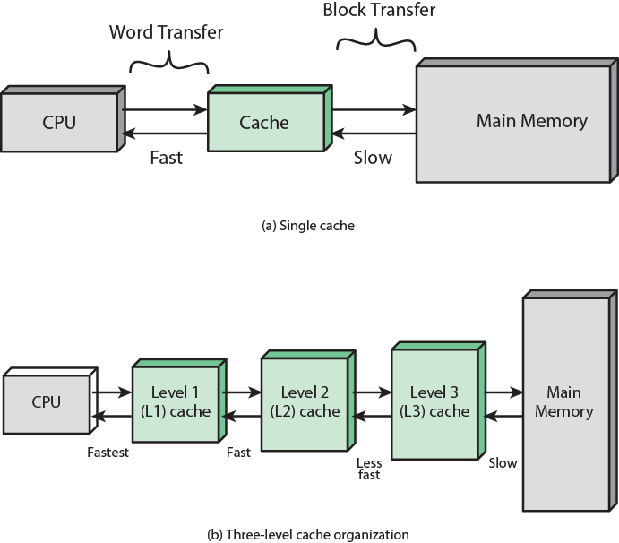
Cache and Main Memory: Single cache
Can memory access speed be improved?

Slide 79
Cache and Main Memory: Three-level cache
Can memory access speed be improved?

Slide 80
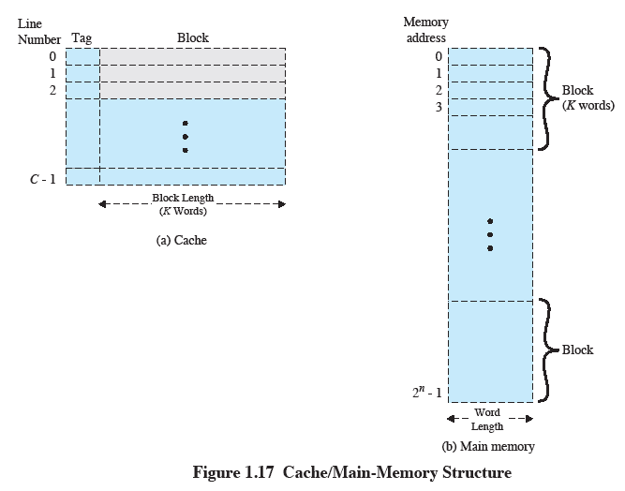
Cache / Main-memory Structure
Can memory access speed be improved?

Slide 81

Locality of reference
Locality of reference is key to limiting the number of pages that must be present in memory at any time, thus enabling an efficient implementation of virtual memory and the process concept.

Slide 82
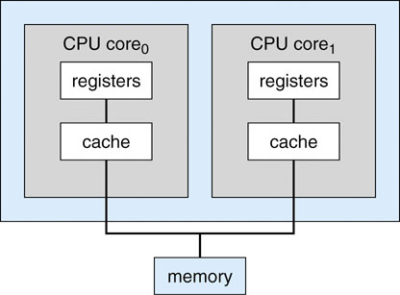
Model of a dual-core processor
Can processor speed be improved?
CPU core₀
CPU core₁
registers
registers
cache
cache
memory

Slide 83
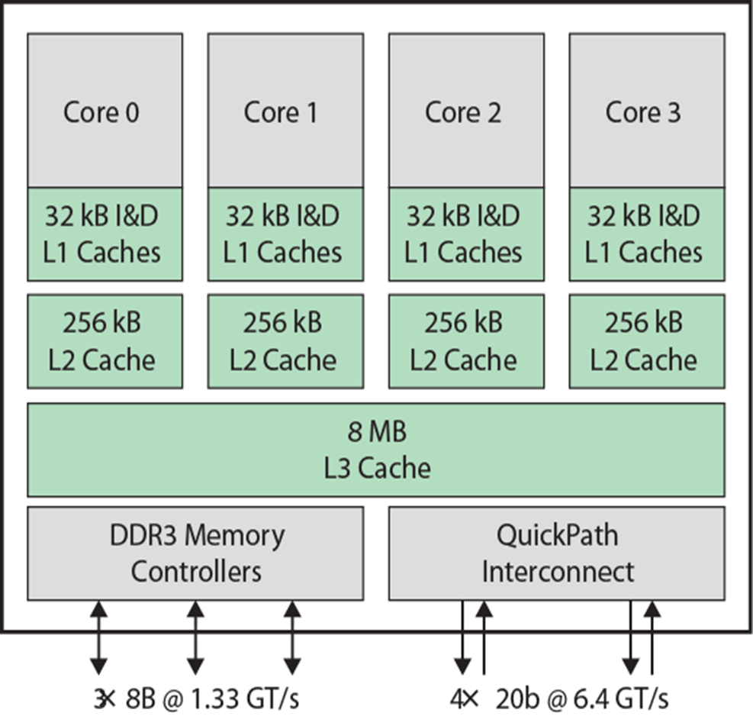
Intel Core i7 Block Diagram
Can processor speed be improved?

